Slide 1

Building an
Interpretive
Budget
Ministry
Plan
Mission
The purpose of an
Interpretive Ministry Plan
is to help the congregation
connect the dots between the Mission of the church
and the Money it takes
to make that mission fly.
$
$
$
$
$
$
$

Slide 2
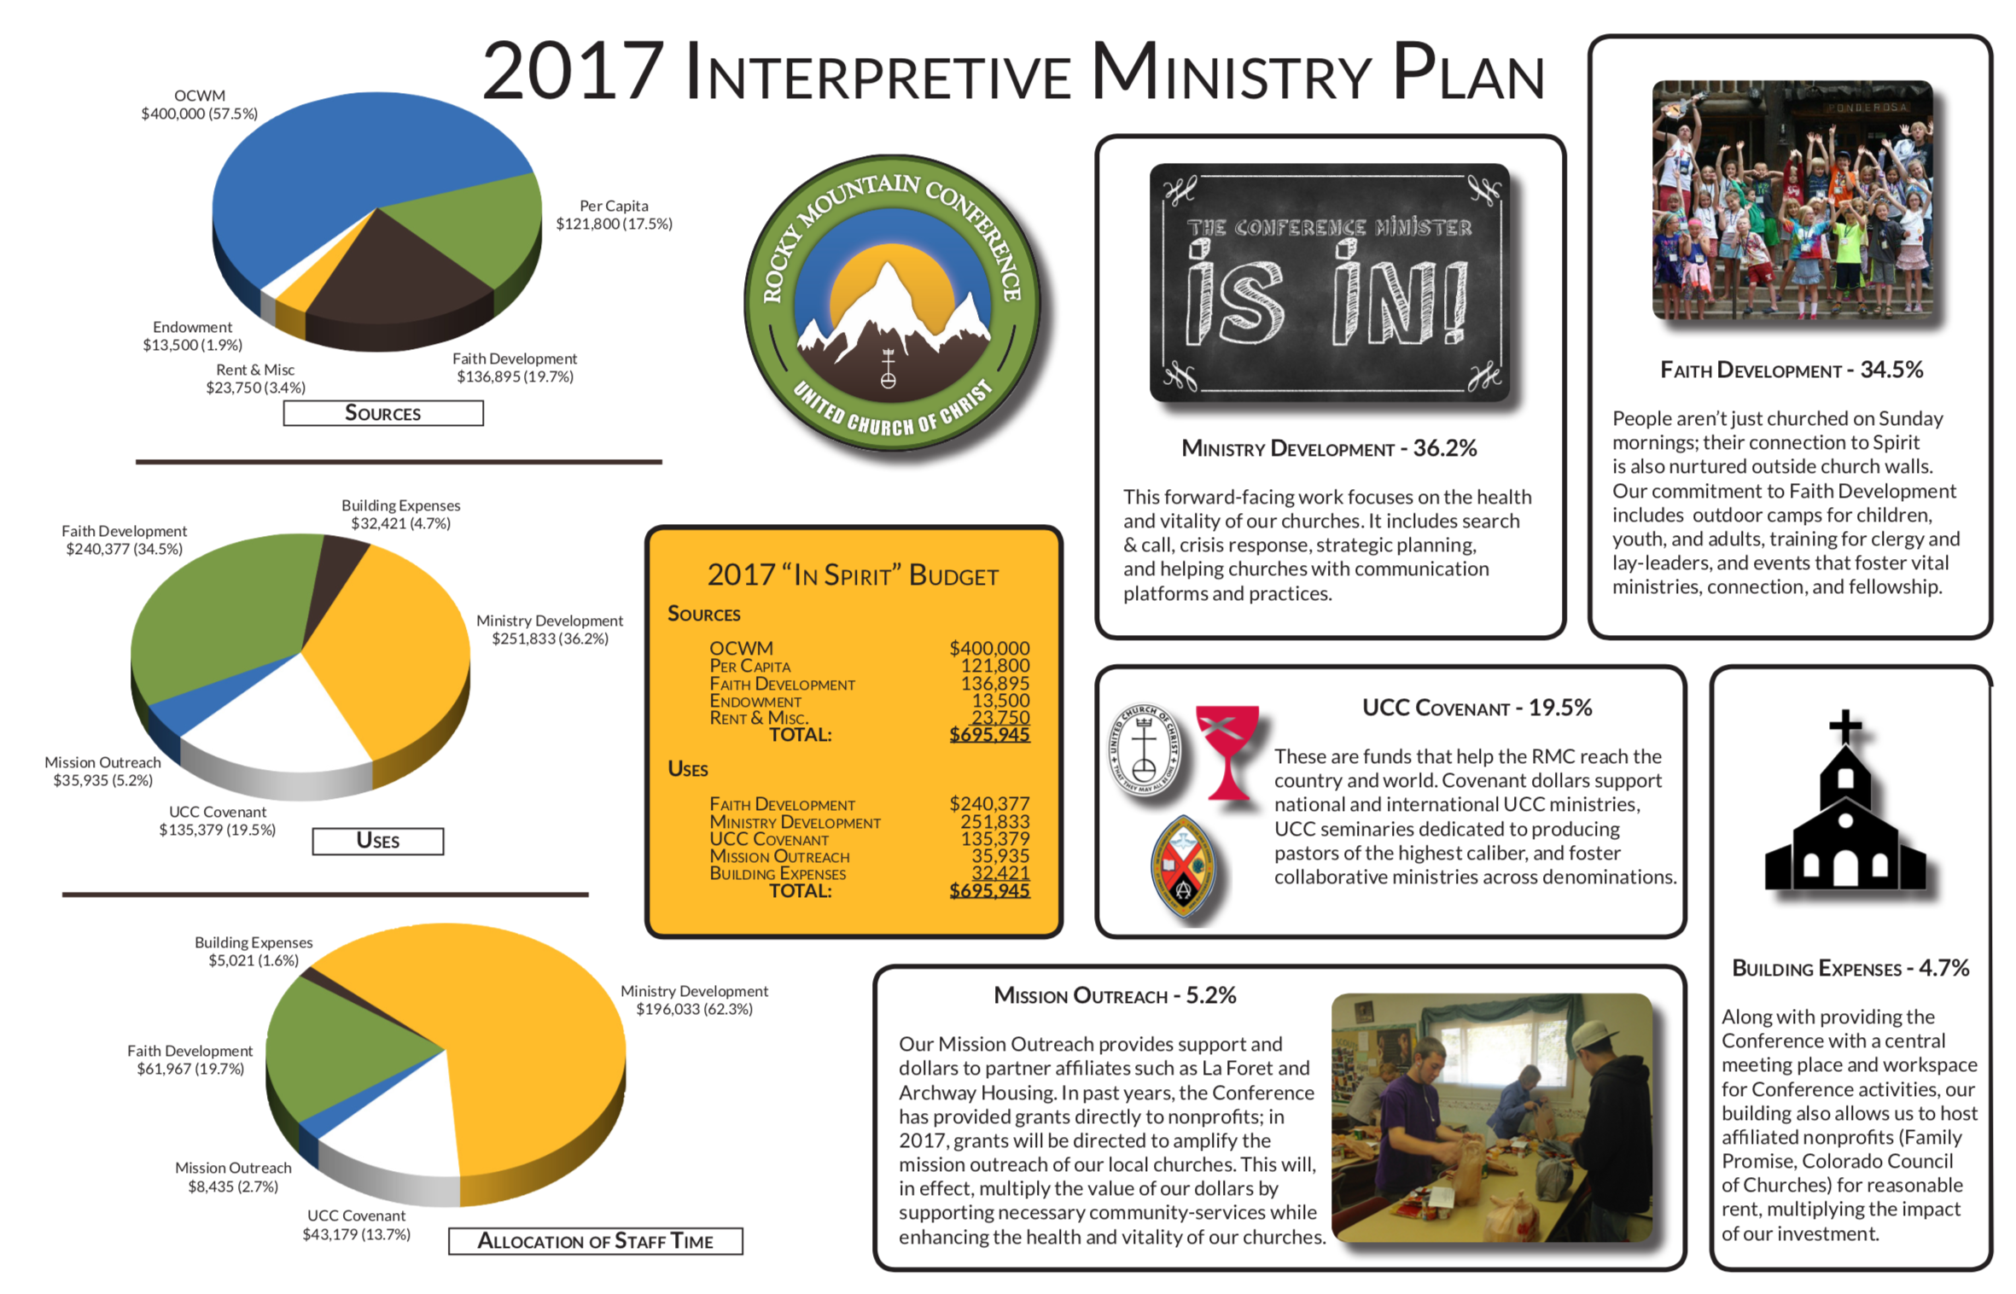

Slide 3
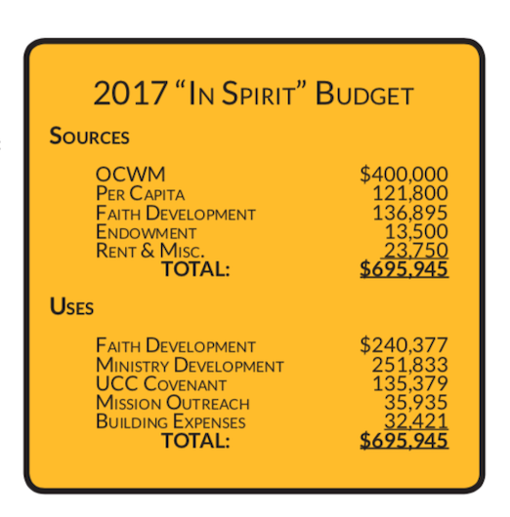
A Sources and Uses Analysis simplifies a more complex budget, helping people connect the inflow of Funding
to the outflow of Ministry.

Slide 4
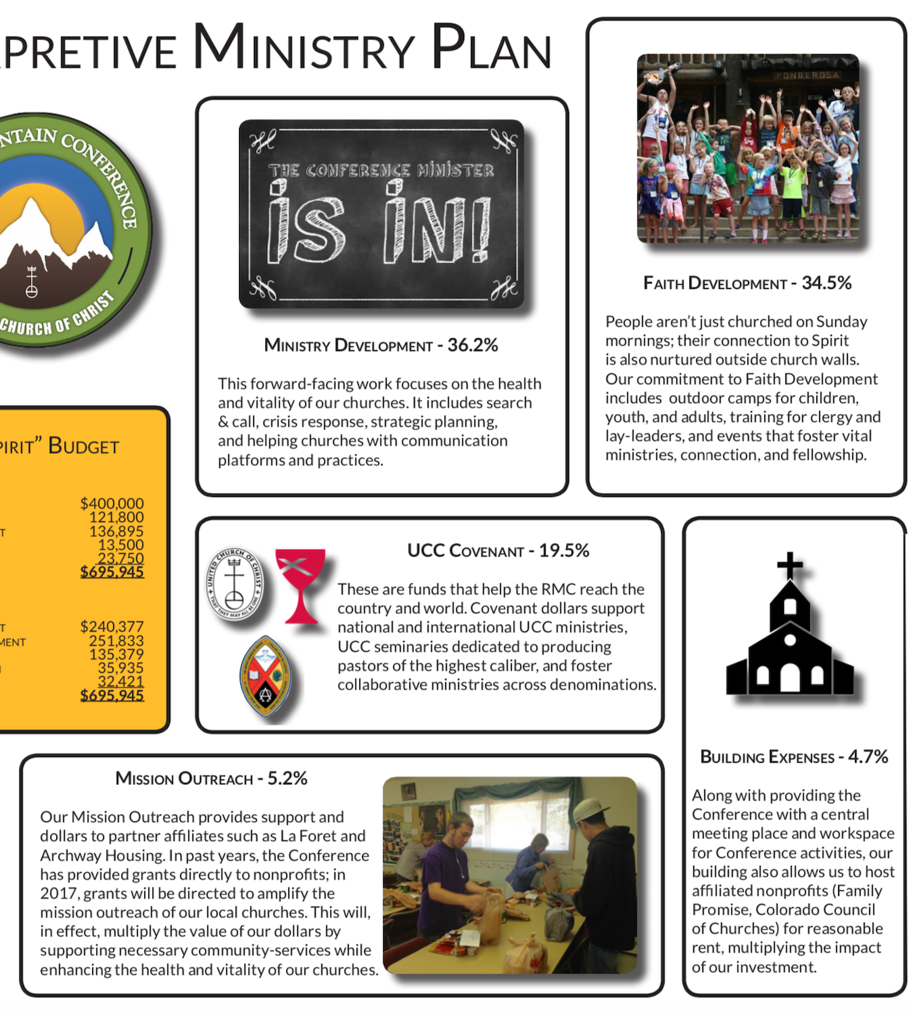
These five Ministry “buckets” help focus attention on the Ministry of the Conference, so people can understand what difference funding makes.
Is it true?
“A picture is worth a thousand words.”

Slide 5
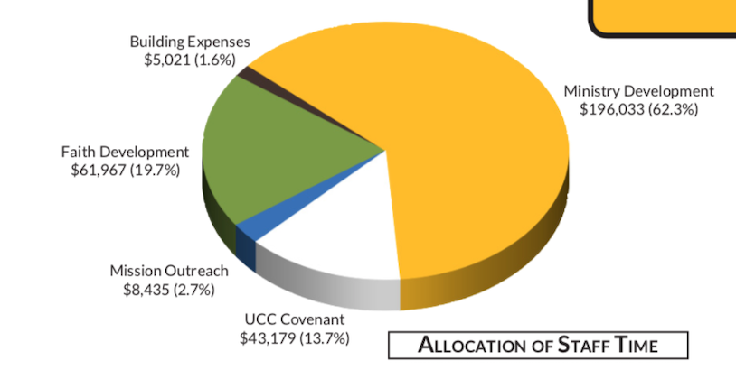
Staff expenses are not featured as a separate ministry bucket.
Instead, each staff salary is allocated among the ministry buckets, essentially driving home the point that the ministry happens through the people…the staff are not just “overhead.”

Slide 7
Building an
Interpretive
Budget
Ministry
Plan
Begin with your church Mission
Determine your Ministry “buckets”
Place budget line items into buckets
Allocate staff expenses into buckets
Calculate your bucket totals $ and %
Choose graphics for buckets
Choose pictures & write copy

Slide 9

Budget Basket
Exercise

Slide 12
Building an
Interpretive
Budget
Ministry
Plan
What possibilities do you see?
What concerns do you have?
Will you offer this to your church?

